Slide 1
Gamepoint HR Database
Francis Odo

Slide 2
Business Scenario
Business requirement
Gamepiont Corp is experiencing explosive growth with a sudden appearance onto the gaming scene with its new AI-powered video game console. As a result, they have gone from a small 10 person operation to 300 employees and 5 locations in under a year. HR department at Gameponit is having trouble keeping up with the growth since they are still maintaining employee information in a spreadsheet. While that worked for ten employees, it has become increasingly cumbersome to manage as the company expands.
As such, the HR department has tasked you, as the new data architect, to design and build a database capable of managing their employee information.
Dataset
The HR department at (Gamepoint) provided an Excel workbook consisting of 310 records, with 14 columns. The data is in human-readable format and has not been normalized at all. The data lists the names of employees at Gamepoint Corp, as well as information such as job title, department, manager's name, hire date, start date, end date, work location, and salary.

Slide 3
Step 1
Data Architecture Foundations

Slide 4
Data Architect Business Requirement
Purpose of the new database:
What is the business partner requesting?: Design and create a database for the HR department
Describe current data management solution:
What is the current method data storage/management?: Currently, the HR department maintain information in a shared Excel spreadsheet, managed by HR MAnager
Describe current data available:
What data does the business currently have available?: An Excel spreadsheet with employee information consisting 206 records such as job title, department, manager's name, hire date, start date, end date, work location, and salary.
Additional data requests:
Does the user have future data requests?: Interface and connect to the Payroll Department database for employee payroll and timesheet information.
Who will own/manage data
What department will own / manage the data in the database?: The HR department will own the database. It will be managed by the HR Manager
Who will have access to database
List user types that will have access; also list any restrictions to access. ===> The HR Manager (Read/Write), HR employee (Read Only) with restriction to salary information

Slide 5
Data Architect Business Requirement
Estimated size of database
List the size of the database in terms of numbers of rows. Business users often understand row or column size instead of GBs or MBs: 206 rows, expected 20% growth over 5 yrs, to about 406 Rows (1GB size allocation)
Estimated annual growth
List any expected growth to the data:The expected and projected growth is 20% over 5 yrs from 206 rows of records
Is any of the data sensitive/restricted
List any data that may be sensitive or restricted from particular users:
The Database access is restricted. No access by any user
The employee salary table is restricted to all users

Slide 6
Data Architect Technical Requirement
Justification for the new database
Provide at least two justifications for building a database:
1. The number of employees have increased significantly from 10 to 200 and the data size is getting increasingly difficult to manage.
2. The integrity of the data is at risk because security provision in Excel is limited. A fully functional Relational Database will offer read/write capabilities in a secured and controlled access form.
Database objects
List the database objects (tables, views, special procedures) that will be created for the database. : Tables:(Employee, Department Employee_Information, Manager, Salary, Location and Education_Level)
Hint - you may want to circle back to this answer after completing the logical ERD in step 2.
Data ingestion
Select a data ingestion method (ETL, Direct feed, API) based on the information provided.
Initially, automated ETL process will be established.
API will be implemented in the future

Slide 7
Data Architect Technical Requirement
Data governance (Ownership and User access)
Ownership: who will own and maintain the data: The HR Department will own the database. It will be managed by the HR Manager.
User Access: who will and will not have access to the data
HR Manager will have full access to all Tables,. HR Staff will have Domain Controlled access to all tables except the Salary table
All other users will have Domain Controlled access (read only).
Scalability
Should replication or sharding be used to ensure scalability based on user needs: This is not a requirement for Phase 1
However, replication offers database access to remote sites and/or subsidiaries. A future expansion need.
Sharding provides splitting and storing the logical datasets in multiple databases, which in turn provides more storage capability as the data grows in size. This offers a much required need for scaling.
Flexibility
Describe measures taken to ensure future data integration if needed: 1. The new database implementation allows creation of new features, capability to move data in and out or to a new place, as well as adding more entities as needed. 2. API implementation will offer interface to other systems owned and maintained by other departments, if needed in the future.
Storage & retention
Storage (disk or in-memory): check IT best practices document
Storage Disk
Retention: how long does the data have to be kept for?: 7 yrs.
Backup IT Best Practices document lists Backup schedule requirements:
Standard: Backup schedule is a full backup 1x per week.
Archive: Backup schedule is a full backup 1x per month.
Critical: Backup schedule is full backup 1x per week, incremental backup daily.

Slide 8
Step 2
Relational Database Design

Slide 9
Step 2: Relational Database Design
This step is where you will go through the process of designing a new database for Tech ABC Corp's HR department. Using the dataset provided, along with the requirements gathered in step one, you are going to develop a relational database set to the 3NF.
Using Lucidchart, you will create 3 entity relationship diagrams (ERDs) to show how you developed the final design for your data.
You will submit a screenshot for each of the 3 ERDs you create. You will find detailed instructions for developing each of the ERDs over the next several pages.

Slide 10
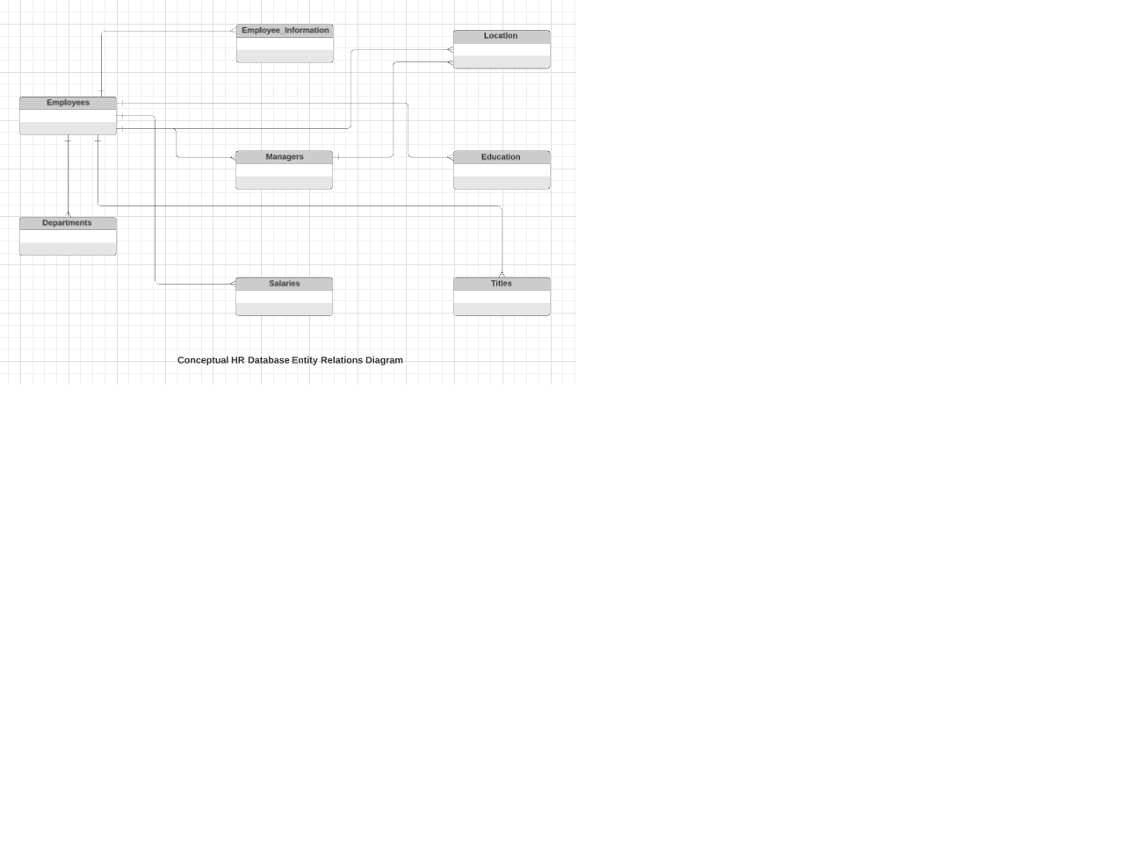
ERD
Conceptual
This is the most general level of data modeling. At the conceptual level, you should be thinking about creating entities that represent business objects for the database. Think broadly here. Attributes (or column names) are not required at this point, but relationship lines are required (although Crow's foot notation is not needed at this level). Create at least three entities for this model; thinking about the 3NF will aid you in deciding the type of entities to create.

Slide 11
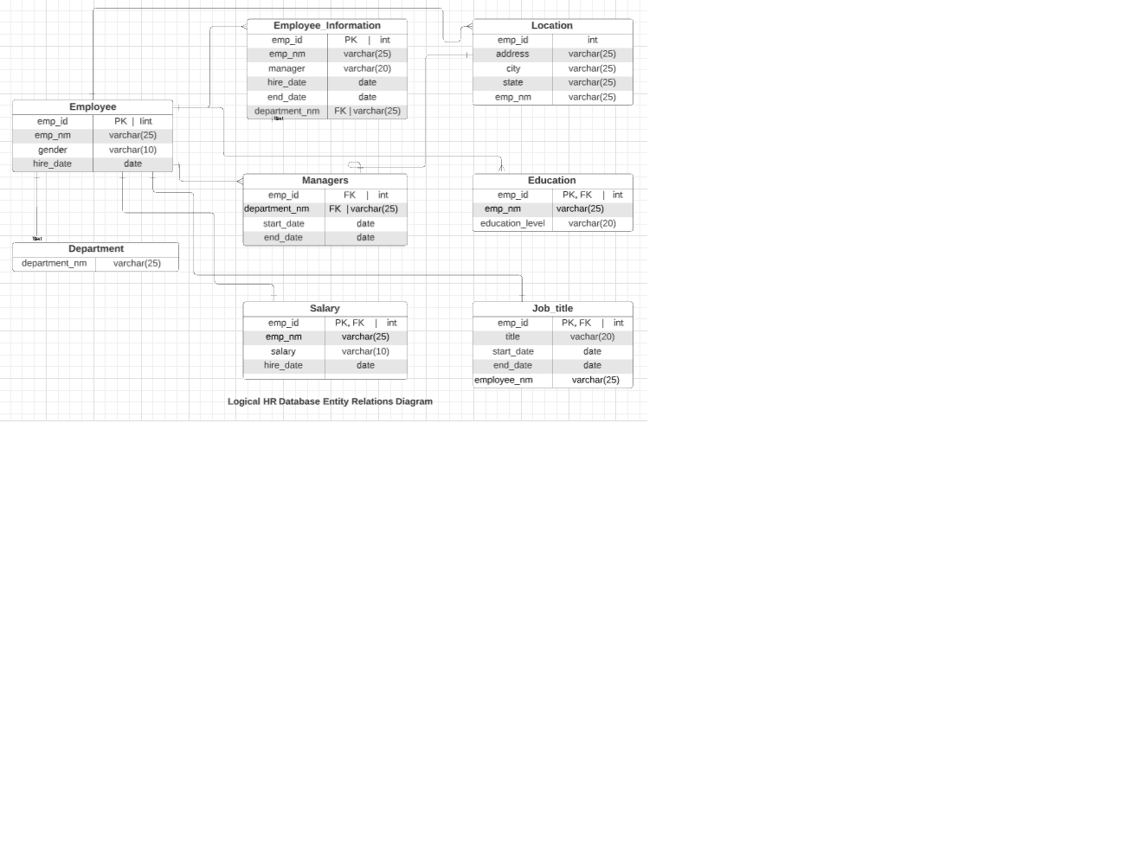
ERD
Logical
The logical model is the next level of refinement from the conceptual ERD. At this point, you should have normalized the data to the 3NF. Attributes should also be listed now in the ERD. You can still use human-friendly entity and attribute names in the logical model, and while relationship lines are required, Crow's foot notation is still not needed at this point.

Slide 12
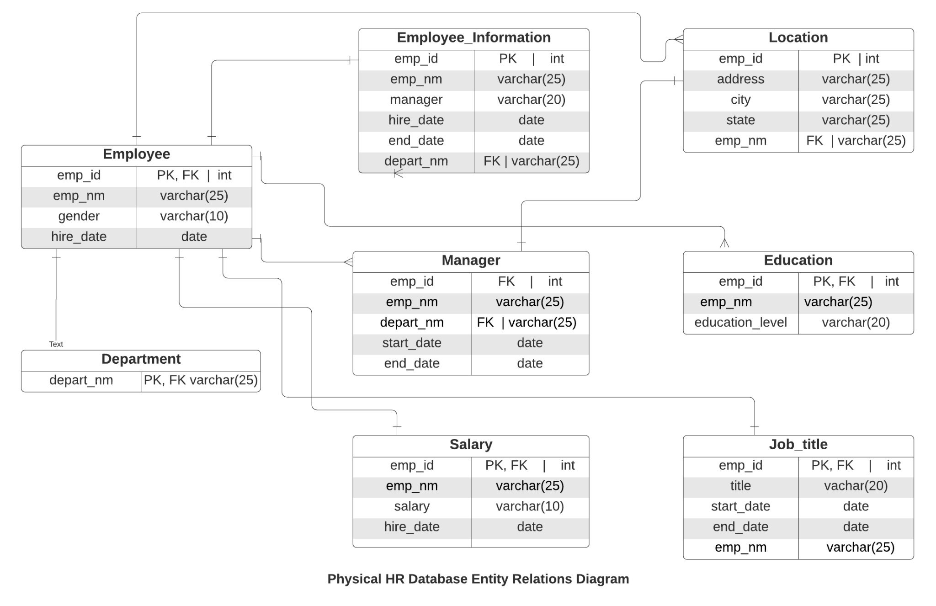
ERD
Physical
The physical model is what will be built in the database. Each entity should represent a database table, complete with column names and data types. Primary keys and foreign keys should also be represented here. Primary keys should be in bold type with the (PK) designation following the field name. Foreign keys should be in normal type face, but have the designation (FK) after the column name. Finally, in the physical model, Crow's foot notation is important.

Slide 13
Step 3
Create A Physical Database

Slide 14
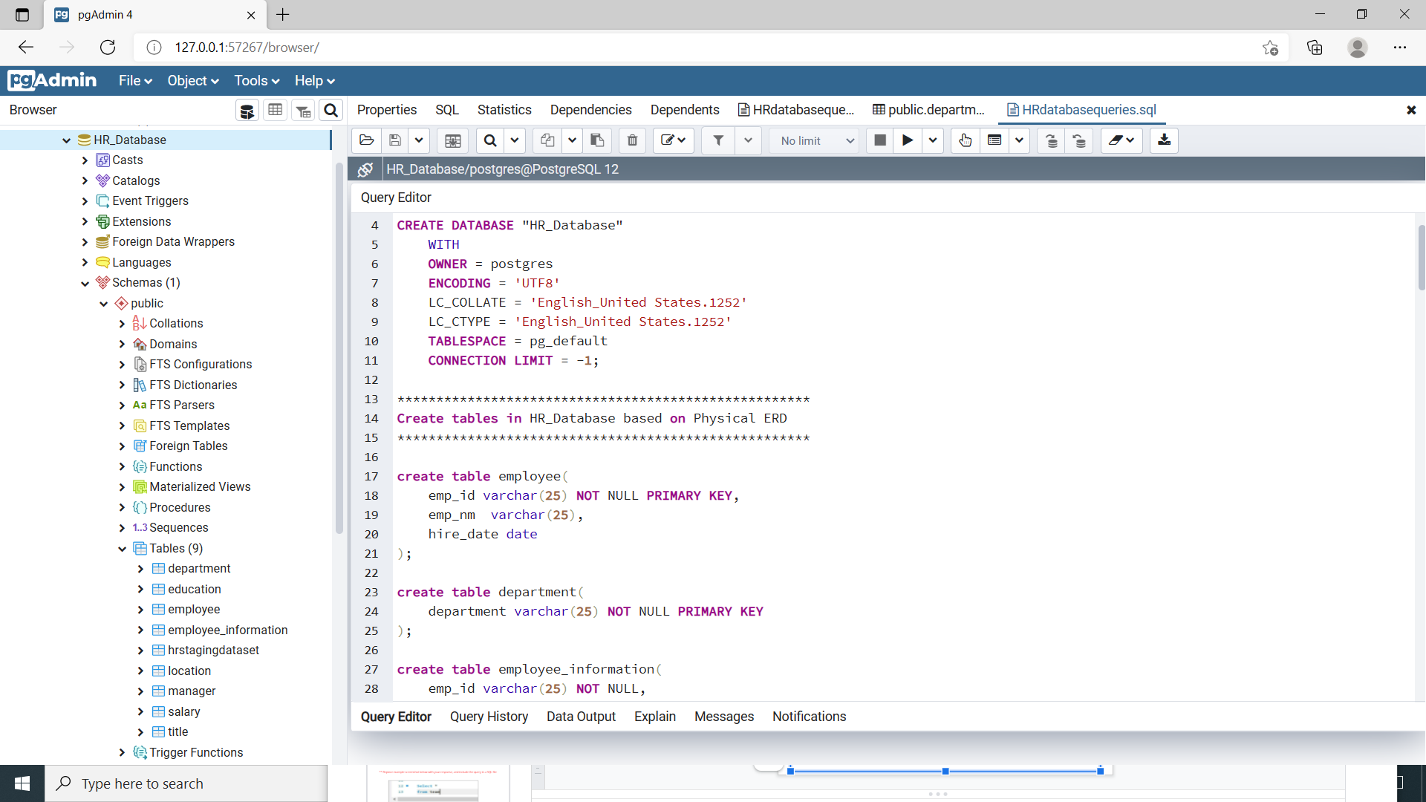
DDL
Create a DDL SQL script capable of building the database you designed in Step 2
SQL code file provided in the zip file.
Sample screenshot of the code:

Slide 15
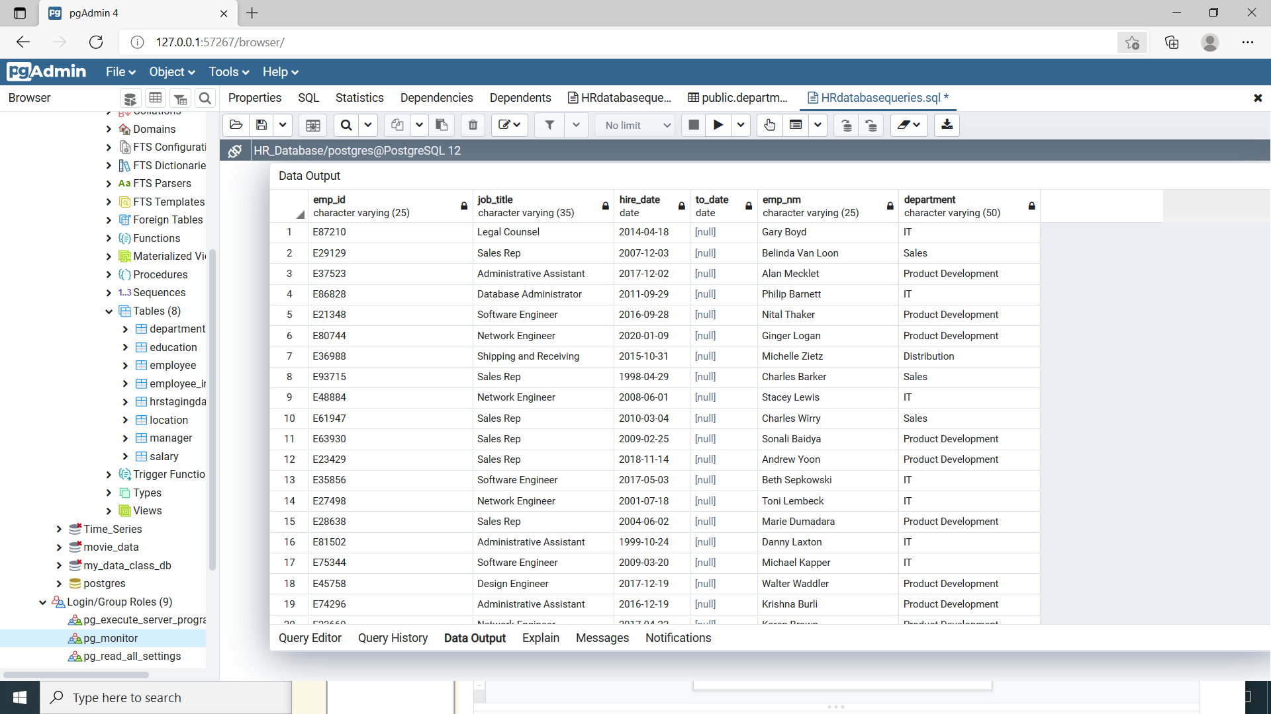
CRUD
Question 1: Return a list of employees with Job Titles and Department Names

Slide 16
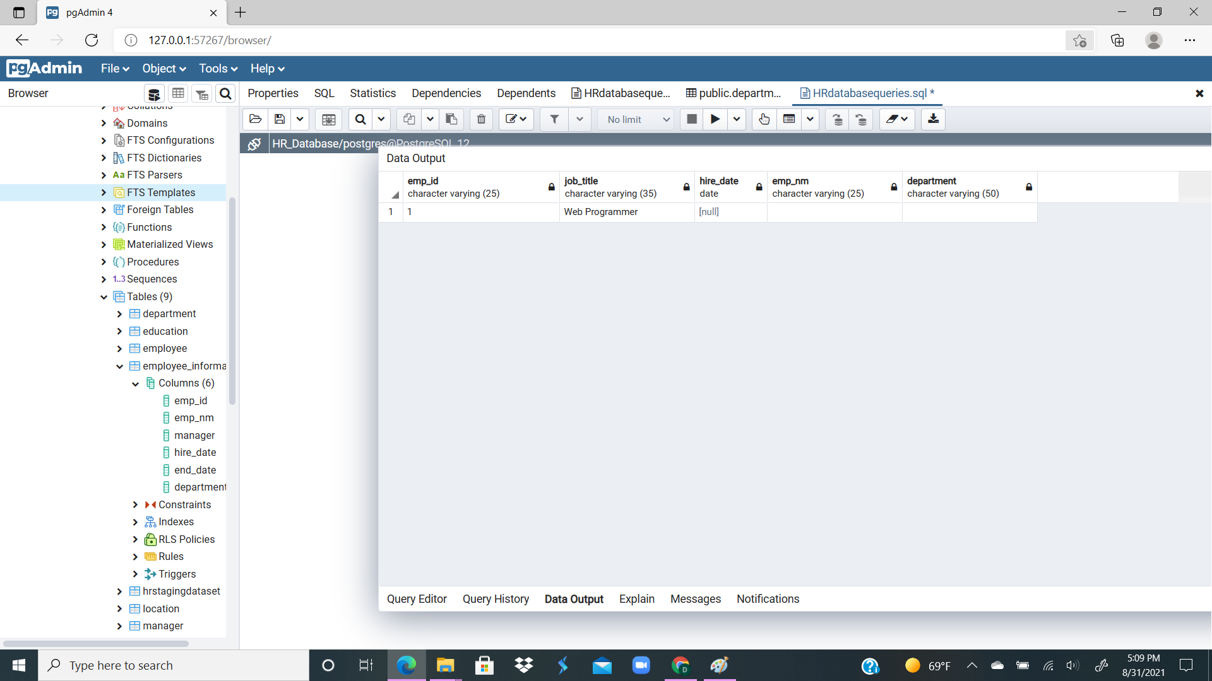
CRUD
Question 2: Insert Web Programmer as a new job title
INSERT INTO title (emp_id, job_title, emp_nm, department) values (1, 'Web Programmer',' ',' ');
select * from title
where job_title = 'Web Programmer'

Slide 17
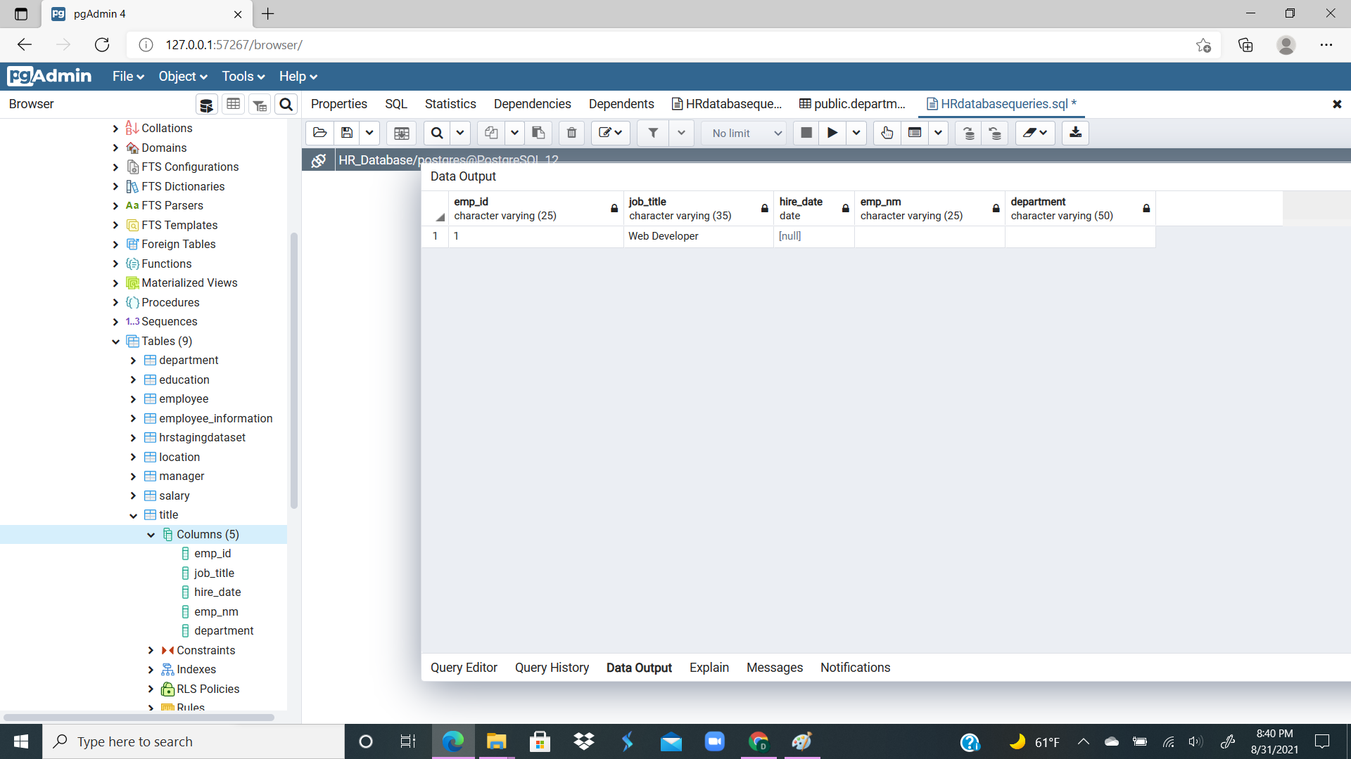
CRUD
Question 3: Correct the job title from web programmer to web developer
UPDATE title
SET job_title = 'Web Developer'
WHERE job_title = 'Web Programmer';
Select * from title
where job_title = 'Web Developer'

Slide 18
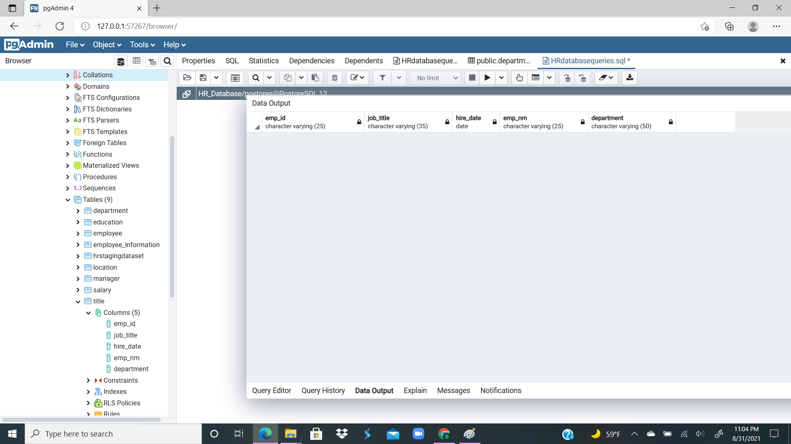
CRUD
Question 4: Delete the job title Web Developer from the database
DELETE FROM title
WHERE job_title = 'Web Developer';
Select * from title
where job_title = 'Web Developer'

Slide 19
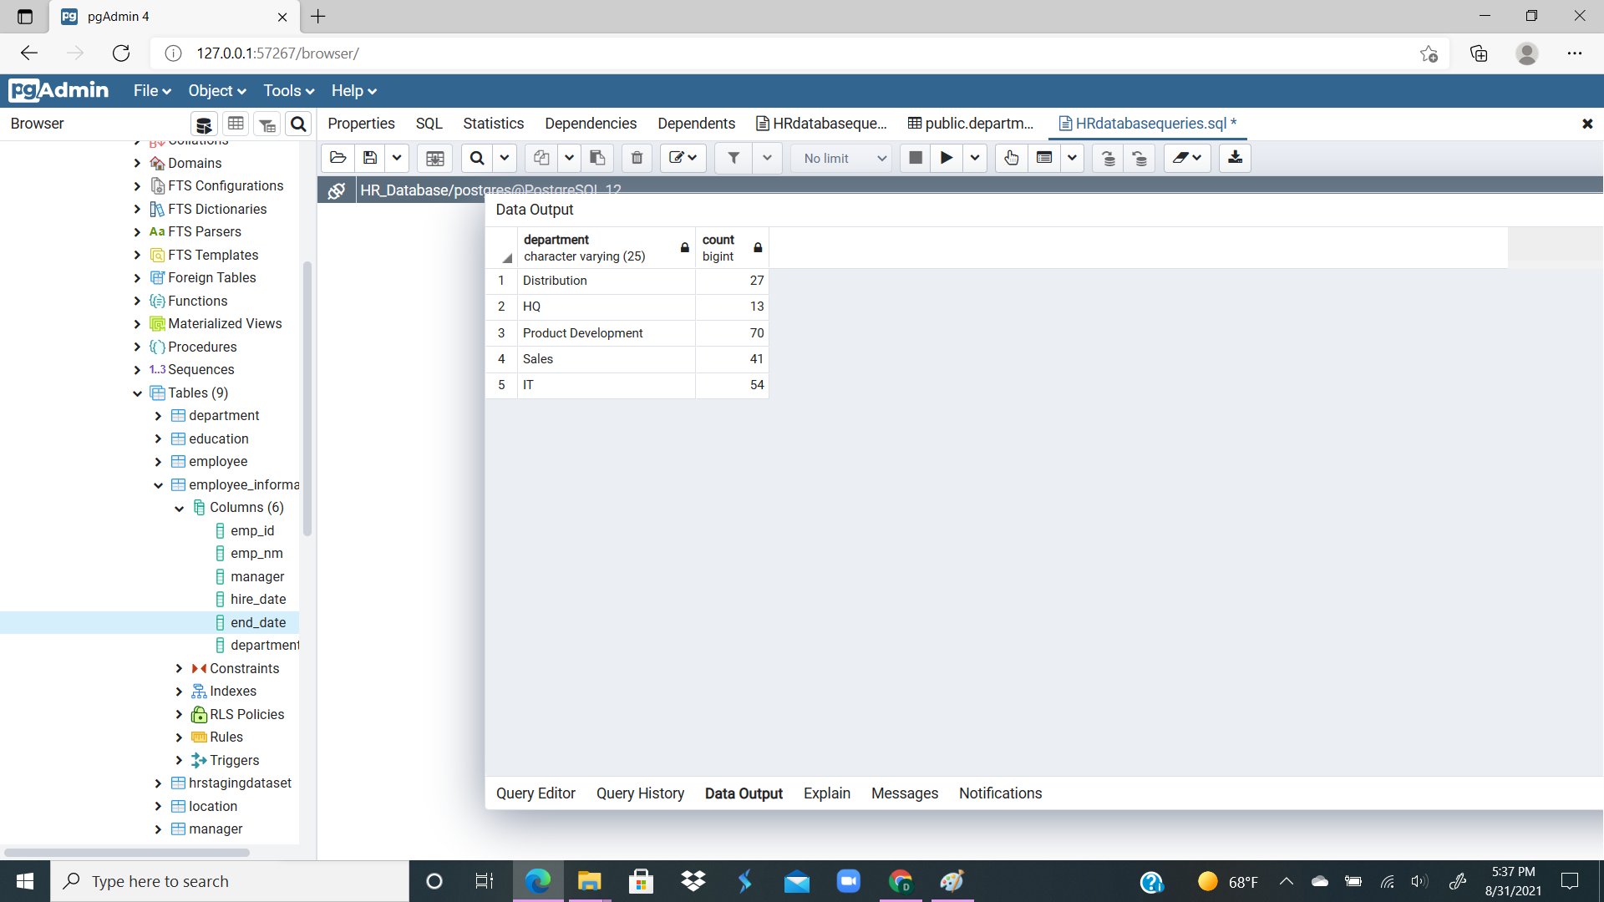
CRUD
Question 5: How many employees are in each department?
Select "department", COUNT("emp_id") from "employee_information"
GROUP BY "department";

Slide 20
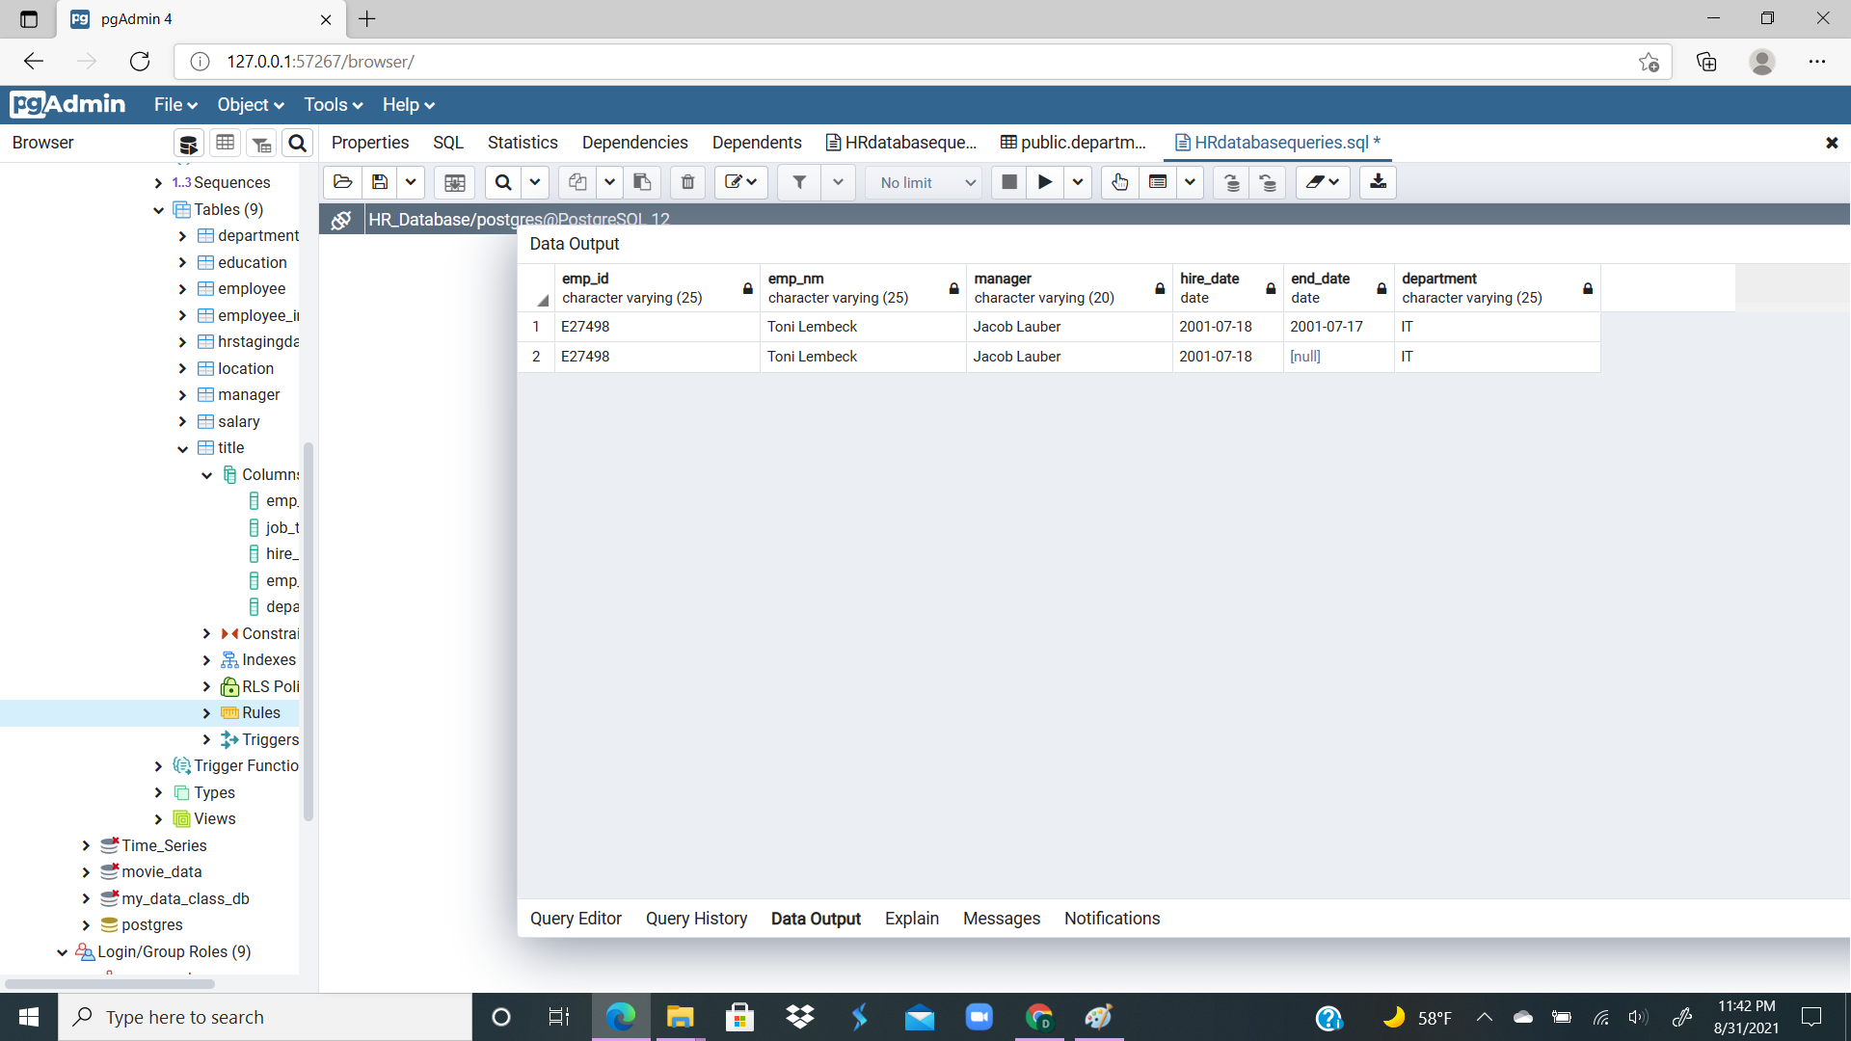
CRUD
Question 6: Write a query that returns current and past jobs (include employee name, job title, department, manager name, start and end date for position) for employee Toni Lembeck.
select * from employee_information
where emp_nm = 'Toni Lembeck';

Slide 21
CRUD
Question 7: Describe how you would apply table security to restrict access to employee salaries using an SQL server.
This can be achieved with Column Level Security
A user with full access to the employee table can currently access all columns in the tale..
First, we want to revoke the user’s access to the employee table.
Second, create a view with only required columns or columns we want the user to see or have access to, and, provide this view access to the user instead.

Slide 22
Appendix

